Slide 1

Project Presentation Course- ALY 6010 submitted by
Ankit Vilas Bhalekar

Slide 2
Introduction:
Wine quality dataset with 12 columns and 0-10 rating scale
Multiple wine types or vintages included in the dataset
Two inquiries to be analyzed:
Difference in mean pH between wines with and without citric acid
Effect of alcohol amount on wine quality rating
Independent two-sample t-tests and correlation analyses will be conducted using R
Linear regression model will be run to examine the connection between quality rating and alcohol content.

Slide 3
Dataset Description:
Dataset contains 12 columns with different attributes of wine
Columns detail the chemical makeup of wine and its quality rating on a 0-10 scale
Each row represents a separate wine sample
Several rows have identical features but different quality ratings
Indicates dataset contains data about multiple wine types or vintages.

Slide 4
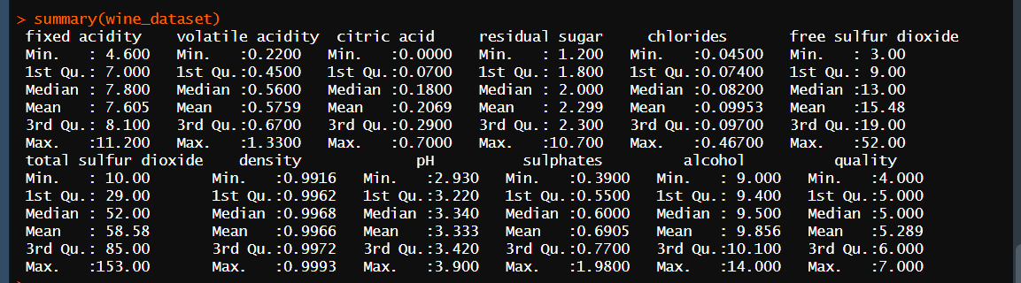
Summary of the dataset:

Slide 5
Q1) Is there a substantial difference between wines with and without citric acid in the mean pH of the wine?
Methodology: Independent two-sample t-test
Null Hyp.: There is no significant variation in the mean pH between the two groups
Alt hyp: There is a considerable variation variation in the mean pH between the two groups
Statistical software package: R
Steps:
Separate dataset into two groups: wines with citric acid and wines without citric acid
Perform t-test to compare mean pH of each group
Null Hypothesis statement: For wines with and without citric acid, there is no discernible difference in the mean pH of the wine.
Alternative Hypothesis statement: Between wines with and without citric acid, there is a considerable change in the mean pH of the wine.

Slide 6
Output and Description:
Degrees of freedom: 27.028
t-value: -5.925
p-value: 2.568e-06 (low)
Conclusion: Null hypothesis is strongly refuted, indicating a significant difference in the mean pH of the wine between samples with and without citric acid.
95% confidence interval of the difference in means: (-0.2328530, -0.1130672)
Sample mean pH in the group with citric acid: 3.312595
Sample mean pH in the group without citric acid: 3.485556
Conclusion: Presence of citric acid may be associated with lower pH levels in wine as the mean pH for the group with citric acid is lower than the mean pH for the group without citric acid.

Slide 7
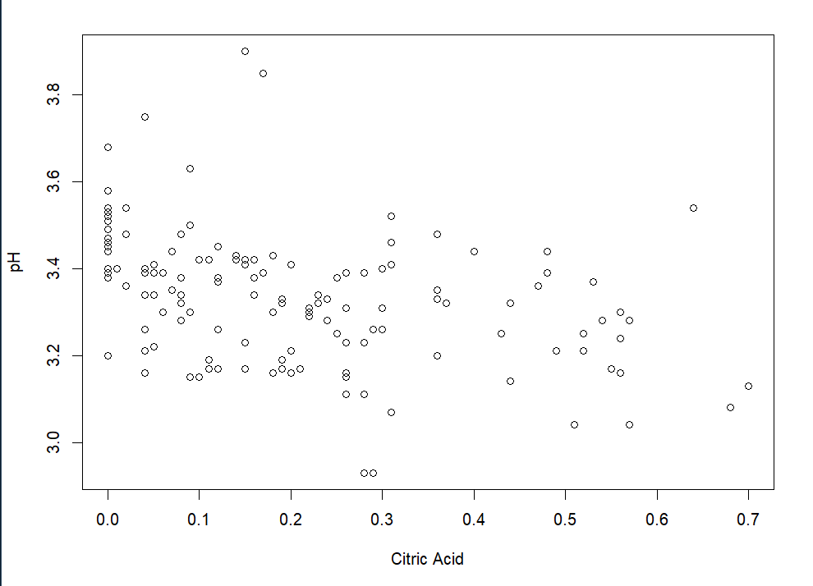
Scatter Plot:1

Slide 8
Q1) Is there a strong connection between the wine's alcohol concentration and its rating for quality?
Correlation analysis using t-test (two sampled)
Objective: to determine if there is a significant relationship between alcohol concentration and wine quality rating
Null hypothesis: no significant interrelationship between alcohol content and quality rating of wine
Alternative hypothesis: significant interrelationship between alcohol content and quality rating of wine

Slide 9
Output and Description:
Pearson correlation analysis was conducted on alcohol concentration and wine quality rating
Correlation coefficient is 0.1639787
P-value is 0.04568
Positive correlation between alcohol content and quality rating
P-value indicates a significant relationship between the two variables
Null hypothesis is rejected
Conclusion: There is a significant link between alcohol concentration and wine quality rating, as the P-value is less than the significance threshold of 0.05.

Slide 10
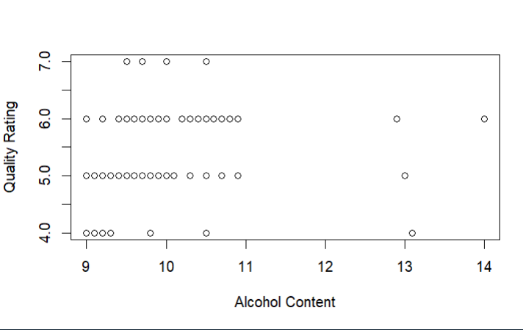
Scatter Plot:2

Slide 11
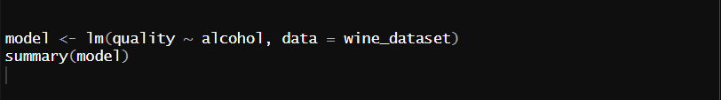
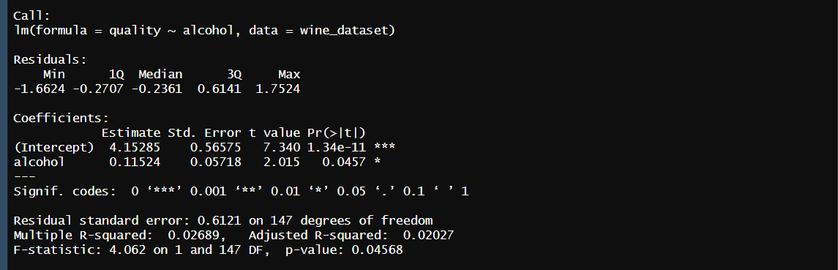
Simple linear regression mode
Output:

Slide 12
Output and Description:
Linear regression model:
Dependent variable: quality rating
Independent variable: alcohol concentration
Output summary:
Estimated intercept and slope of regression line
Standard errors, t-values, and p-values for intercept and slope
Consistent findings:
P-value for slope coefficient (0.0457) same as correlation test
Variability explained:
Modified R-squared value: 0.02027
Only a small percentage of variability in quality rating explained by alcohol concentration
Association between variables:
Marginally favorable association between alcohol concentration and quality rating
Other factors likely have an impact on quality rating.

Slide 13
Conclusion:
Dataset:
12 columns, including wine attributes and quality ratings
Research questions:
Does mean pH of wines with/without citric acid differ?
Does amount of alcohol in wine impact quality rating?
Analysis methods:
Independent two-sample t-tests
Correlation analysis
Linear regression model
Results:
Mean pH of wines with/without citric acid differs significantly
Lower pH values associated with citric acid content
Strong positive link between alcohol concentration and quality rating
Implications:
Results may help wine business understand how alcohol and citric acid affect wine quality
Limitations:
Assumptions made about data normality and absence of outliers should be highlighted.

Slide 14
Thankyou !

